Slide 1
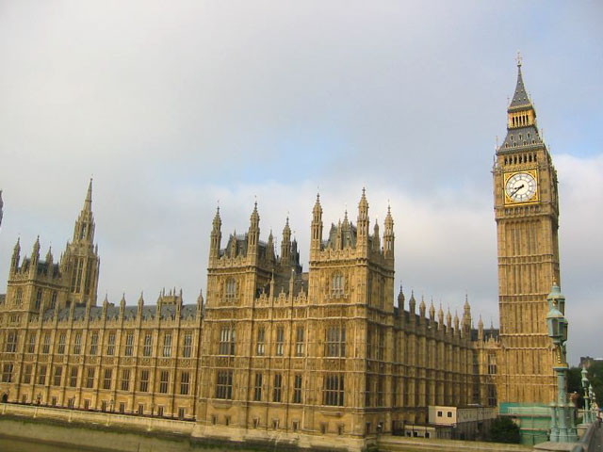
Hello!

Slide 2
Topic of our lesson:
«The construction There is / There are in the Past Simple»
Цели урока:
Формирование коммуникативной компетенции.
Формирование грамматических навыков письменной и устной речи.
Развитие навыков визуального запоминания.
Задачи урока:
Научиться использовать грамматическую конструкцию There is / There are в Past Simple в письменной и устной речи.
Обеспечить естественную необходимость многократного повторения ими языкового материала;
Тренировать учащихся в выборе нужного речевого варианта, что является подготовкой к ситуативной спонтанности речи.

Slide 3
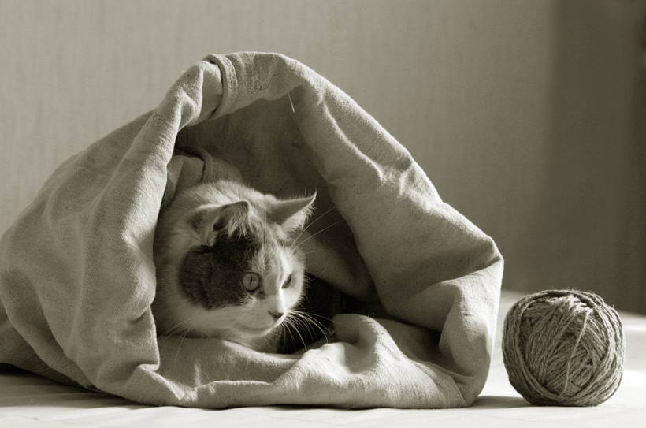
There is a cat in a bag.

Slide 4
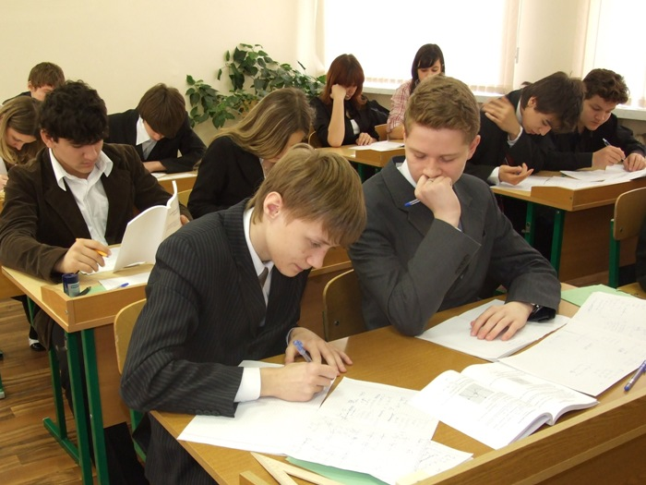
Present Simple tense
Past Simple tense
There is/ There are There was/ There were
There are eleven children
in the classroom.
There were eleven children
in the classroom.

Slide 5
Plural
Singular
was were
There was
a pen on the table.
There were books on the table.

Slide 6
Find mistakes, please…
was
were
There were ten pens on the table.
There was seven chairs and a table at my home.
were
There was three books in my bag.
There was many students there.
There were an old lady in your garden.
were

Slide 7
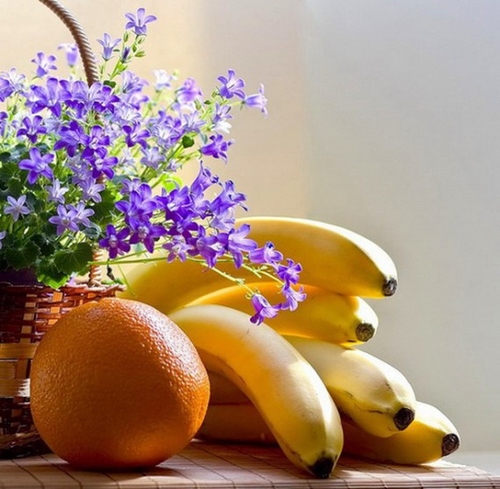
What was there on the table?

Slide 8
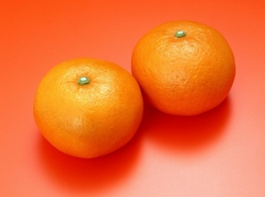
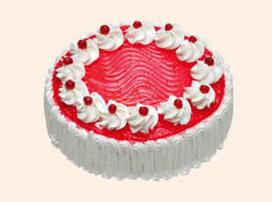
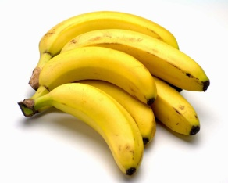
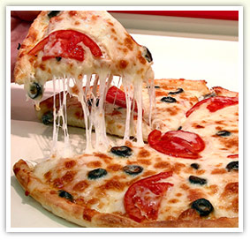
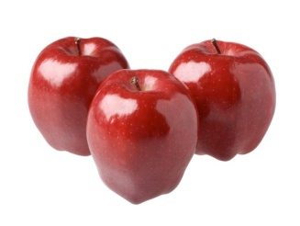
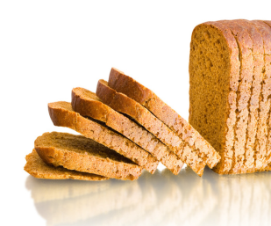
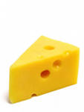
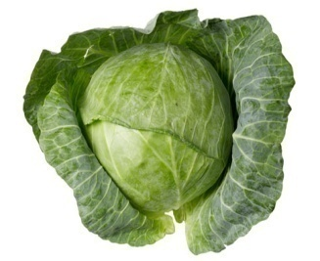
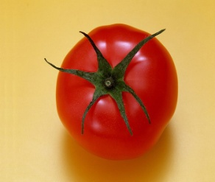
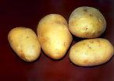
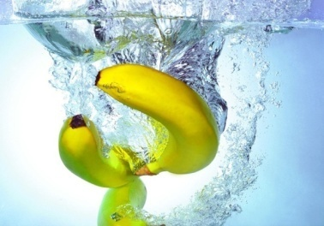
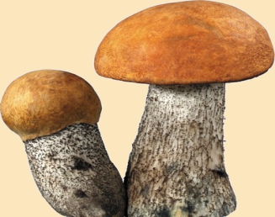

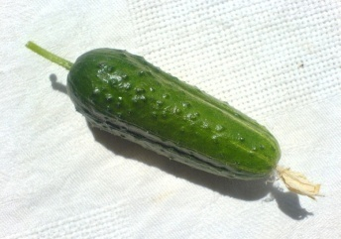
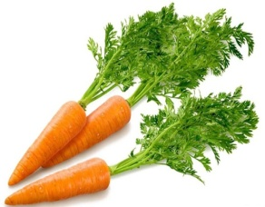

1 row | 2 row | 3 row
Model:There were three books on the first place.

Slide 9
Homework
ex. 1 on page 196
ex. 2 on page 196
rules on page 196

Slide 10
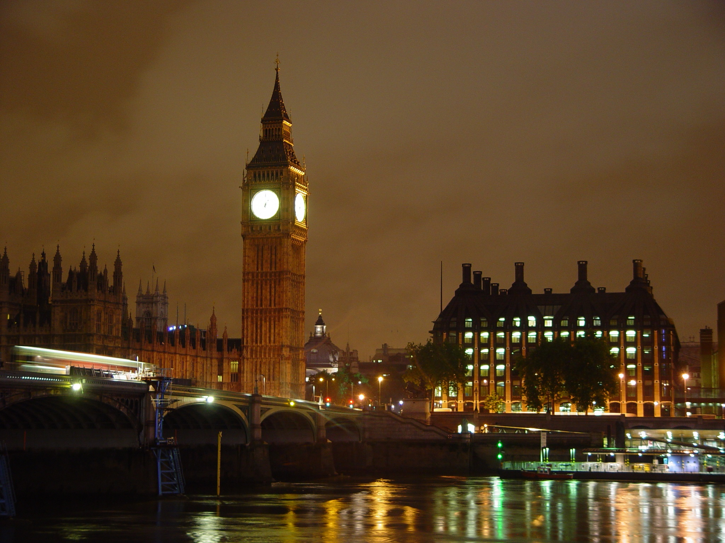
Good bye!

